Slide 1

CHAPTER 9
COUNTING AND PROBABILITY
Copyright © Cengage Learning. All rights reserved.

Slide 2

9.5
Counting Subsets of a Set: Combinations
Copyright © Cengage Learning. All rights reserved.

Slide 3
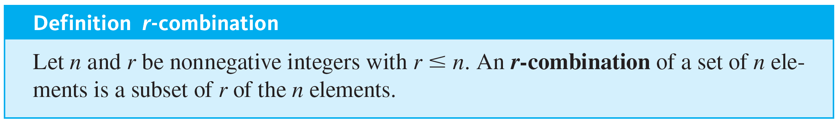
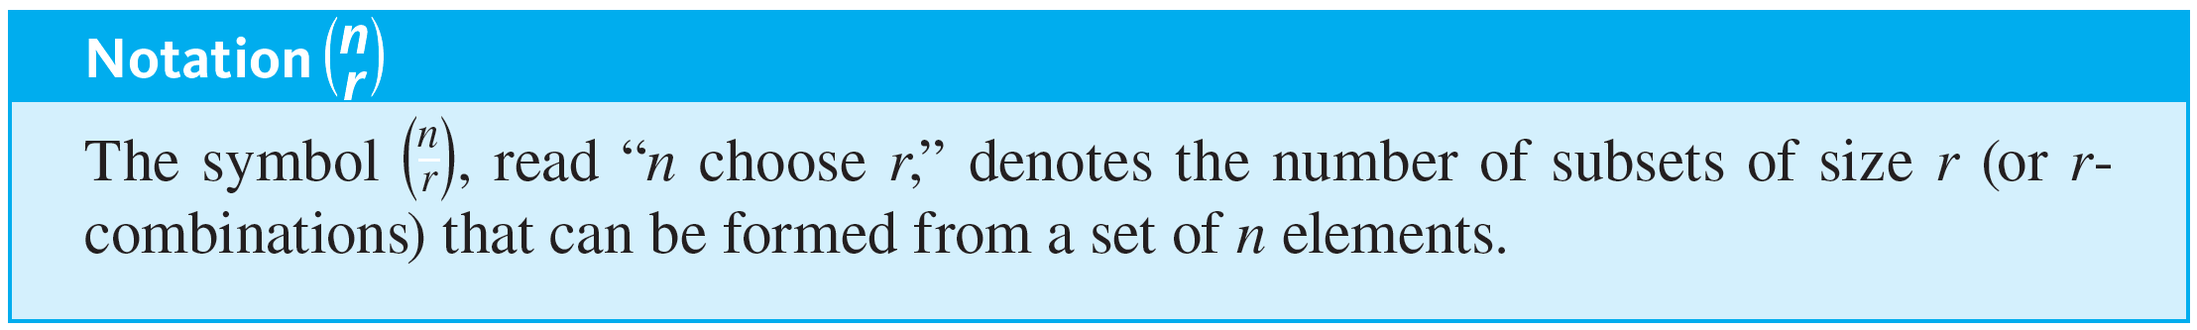
Counting Subsets of a Set: Combinations
The number of subsets of size r that can be chosen from S equals the number of subsets of size r that S has. Each individual subset of size r is called an r-combination of the set.

Slide 4

Example 9.5.1 – 3-Combinations
Consider a set consisting of 4 people: Ann, Bob, Cyd, and Dan.
a. Given the set {Ann, Bob, Cyd, and Dan}, each subset of size 3 is a 3-combination of its elements. List all the 3-combinations of the set.
b. Use the result of part (a) to find
c. In how many ways can the people in the set form a committee of size 3?

Slide 5

Example 9.5.1 – Solution
a. Each 3-combination (subset of size 3) can be obtained by leaving out one of the elements of the set:
{Bob, Cyd, Dan} leave out Ann
{Ann, Cyd, Dan} leave out Bob
{Ann, Bob, Dan} leave out Cyd
{Ann, Bob, Cyd} leave out Dan.
b. There are 4 items in the list of 3-combinations in part (a).
So,

Slide 6
Example 9.5.1 – Solution
continued
c. The number of ways for the people in the set to form a committee of size 3 is the number of distinct such committees, which is the same as the number of subsets of size 3 and equals the number of 3-combinations of elements in the set.
Thus there are 4 ways the people in the set can form a committee of size 3.

Slide 7
Counting Subsets of a Set: Combinations
There are two distinct methods that can be used to select r objects from a set of n elements. In an ordered selection, it is not only what elements are chosen but also the order in which they are chosen that matters.
Two ordered selections are said to be the same if the elements chosen are the same and also if the elements are chosen in the same order. An ordered selection of r elements from a set of n elements is an r-permutation of the set.

Slide 8
Counting Subsets of a Set: Combinations
In an unordered selection, on the other hand, it is only the identity of the chosen elements that matters. Two unordered selections are said to be the same if they consist of the same elements, regardless of the order in which the elements are chosen.
An unordered selection of r elements from a set of n elements is the same as a subset of size r or an r-combination of the set.

Slide 9
Example 9.5.2 – Unordered Selections
How many unordered selections of two elements can be made from the set {0, 1, 2, 3}?

Slide 10

Example 9.5.2 – Solution
An unordered selection of two elements from {0, 1, 2, 3} is the same as a 2-combination, or subset of size 2, taken from the set. These can be listed systematically:
{0, 1}, {0, 2}, {0, 3} subsets containing 0
{1, 2}, {1, 3} subsets containing 1 but not already listed
{2, 3} subsets containing 2 but not already listed.
Since this listing exhausts all possibilities, there are six subsets in all. Thus
which is the number of unordered selections of two elements from a set of four.

Slide 11


Counting Subsets of a Set: Combinations
When the values of n and r are small, it is reasonable to calculate values of
using the method of complete enumeration (listing all possibilities). But when n and r are large, it is not feasible to compute these numbers by listing and counting all possibilities.
The general values of
can be found by a somewhat indirect but simple method. An equation is derived that contains
as a factor. Then this equation is solved to obtain a formula for

Slide 12
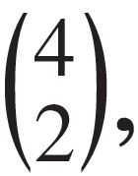

Example 9.5.3 – Relation between Permutations and Combinations
Write all 2-permutations of the set {0, 1, 2, 3}. Find an equation relating the number of 2-permutations, P(4, 2), and the number of 2-combinations,
and solve this equation for

Slide 13
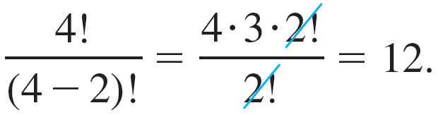
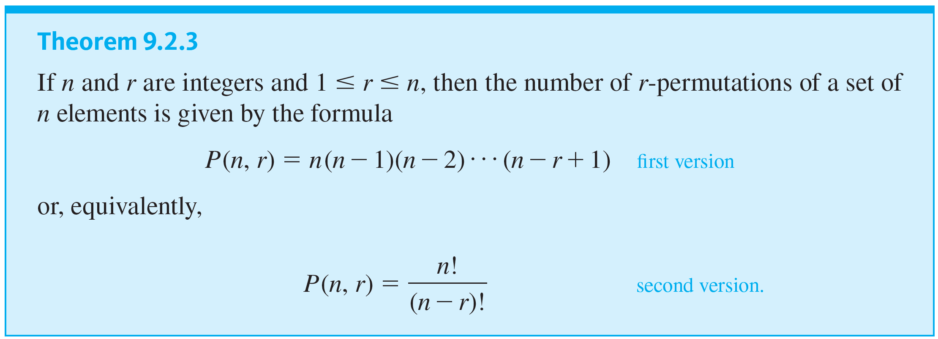
Example 9.5.3 – Solution
According to Theorem 9.2.3, the number of 2-permutations of the set {0, 1, 2, 3} is P(4, 2), which equals

Slide 14
Example 9.5.3 – Solution
continued
Now the act of constructing a 2-permutation of {0, 1, 2, 3} can be thought of as a two-step process:
Step 1: Choose a subset of two elements from {0, 1, 2, 3}.
Step 2: Choose an ordering for the two-element subset.

Slide 15
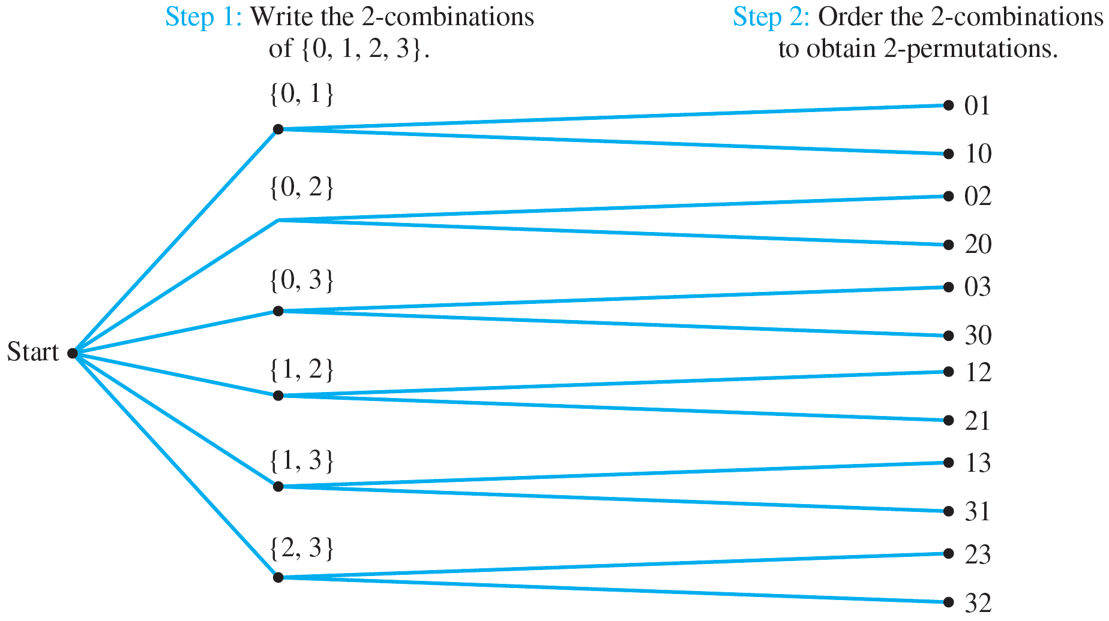
Example 9.5.3 – Solution
continued
This process can be illustrated by the possibility tree shown in Figure 9.5.1.
Relation between Permutations and Combinations
Figure 9.5.1

Slide 16


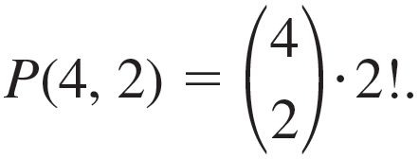

Example 9.5.3 – Solution
continued
the same as the number of subsets of size 2 that can be chosen from {0, 1, 2, 3}. The number of ways to perform step 2 is
The number of ways to perform step 1 is
the number of ways to order the elements in a subset of size 2. Because the number of ways of performing the whole process is the number of 2-permutations of the set {0, 1, 2, 3}, which equals P(4, 2), it follows from the product rule that
This is an equation that relates P(4, 2) and

Slide 17

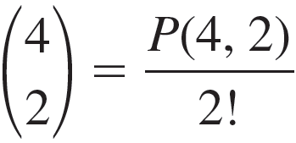
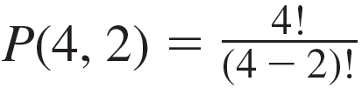
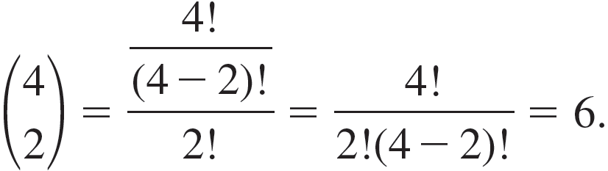
Example 9.5.3 – Solution
continued
Solving the equation for
gives
We know that
So, substituting yields

Slide 18
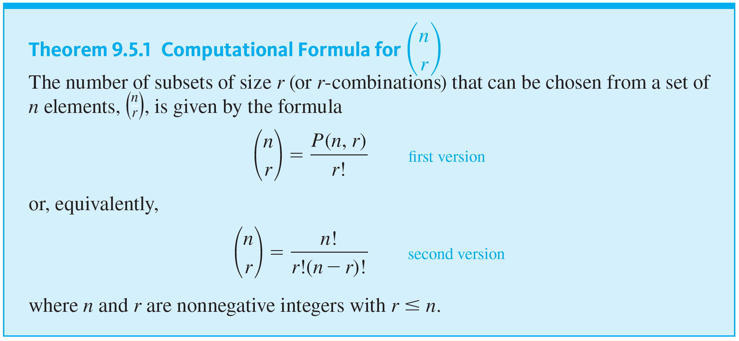
Counting Subsets of a Set: Combinations

Slide 19
Example 9.5.4 – Calculating the Number of Teams
Consider again the problem of choosing five members from a group of twelve to work as a team on a special project. How many distinct five-person teams can be chosen?

Slide 20

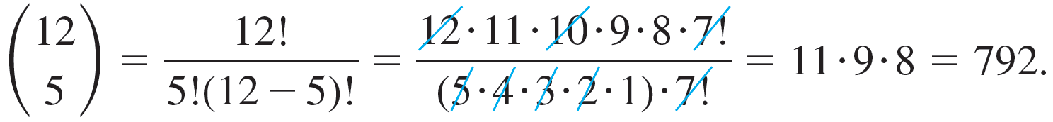
Example 9.5.4 – Solution
The number of distinct five-person teams is the same as the number of subsets of size 5 (or 5-combinations) that
can be chosen from the set of 12. This number is
By Theorem 9.5.1,
Thus there are 792 distinct five-person teams.

Slide 21

Example 9.5.8 – An Application to Graphs
a. Use the multiplication rule to show that K _{m,n}, a complete bipartite graph on (m, n) vertices, has mn edges.
b. Use 2-combinations to show that K _{n}, a complete graph
on n vertices, has
edges.

Slide 22
Example 9.5.8 – Solution
a. A complete bipartite graph on (m, n) vertices, K _{mn}, is a simple graph whose vertices can be divided into two distinct, nonoverlapping sets—say, V with m vertices and W with n vertices—in such a way that there is exactly one edge from each vertex of V to each vertex of W, there is no edge from any one vertex of V to any other vertex of V, and there is no edge from any one vertex of W to any other vertex of W. Label the m vertices of V as v₁, v₂, … , v _{m}.

Slide 23
Example 9.5.8 – Solution
continued
Think of constructing the edges between the vertices of V and the vertices of W as an m-step process: for each integer k from 1 through m, draw exactly one edge from v _{k} to each of the n edges of W.
Because each step can be performed in n ways and there are m steps, by the multiplication rule there are mn ways to construct all the edges. Thus K _{m,n} has mn edges.

Slide 24


Example 9.5.8 – Solution
continued
b. A complete graph on n vertices, K _{n}, is a simple graph with n vertices and exactly one edge between each pair of vertices. If n = 1, then K _{n} has one vertex and 0 edges,
and since
then K _{n} has
edges.
If n ≥ 2, then, since any two distinct vertices of K _{n} are connected by exactly one edge, there are as many edges in K _{n} as there are subsets of size two in the set of n vertices.

Slide 25

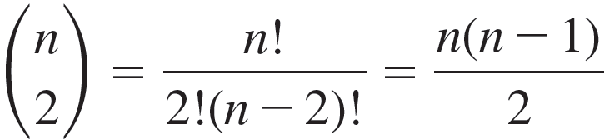

Example 9.5.8 – Solution
continued
By Theorem 9.5.1, there are
such sets, and
Hence K _{n} has
edges.

Slide 26
Example 9.5.9 – Poker Hand Problems
The game of poker is played with an ordinary deck of 52 cards (see Example 9.1.1). Various five-card holdings are given special names, and certain holdings beat certain other holdings. The named holdings are listed from highest to lowest below.
Royal flush: 10, J, Q, K, A of the same suit
Straight flush: five adjacent denominations of the same suit but not a royal flush—aces can be high or low, so A, 2, 3, 4, 5 of the same suit is a straight flush

Slide 27
Example 9.5.9 – Poker Hand Problems
continued
Four of a kind: four cards of one denomination—the fifth card can be any other in the deck
Full house: three cards of one denomination, two cards of another denomination
Flush: five cards of the same suit but not a straight or a royal flush
Straight: five cards of adjacent denominations but not all of the same suit—aces can be high or low
Three of a kind: three cards of the same denomination and two other cards of different denominations

Slide 28
Example 9.5.9 – Poker Hand Problems
continued
Two pairs: two cards of one denomination, two cards of a second denomination, and a fifth card of a third denomination
One pair: two cards of one denomination and three other cards all of different denominations
No pairs: all cards of different denominations but not a straight, or straight flush, or flush, or royal flush
a. How many five-card poker hands contain two pairs?
b. If a five-card hand is dealt at random from an ordinary deck of cards, what is the probability that the hand contains two pairs?

Slide 29


Example 9.5.9 – Solution
a. Consider forming a hand with two pairs as a four-step process:
Step 1: Choose the two denominations for the pairs. Step 2: Choose two cards from the smaller denomination.
Step 3: Choose two cards from the larger denomination. Step 4: Choose one card from those remaining.
The number of ways to perform step 1 is
because there are 13 denominations in all. The number of ways to perform each of steps 2 and 3 is
because there are four cards of each denomination, one in each suit.

Slide 30

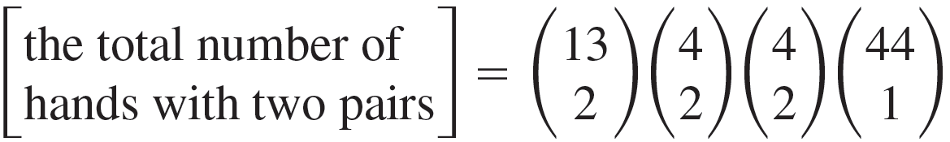
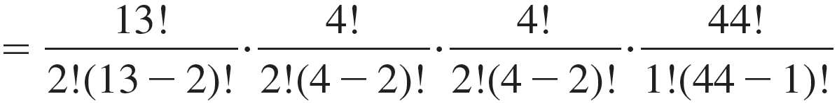
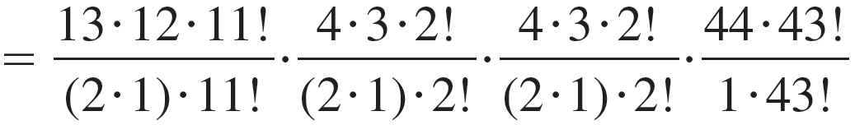

Example 9.5.9 – Solution
continued
because the fifth card is chosen from the eleven denominations not included in the pair and there are four cards of each denomination. Thus
The number of ways to perform step 4 is

Slide 31

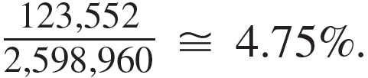
Example 9.5.9 – Solution
continued
b. The total number of five-card hands from an ordinary
deck of cards is
= 2,598,960. Thus if all hands are
equally likely, the probability of obtaining a hand with two
pairs is

Slide 32
Example 9.5.11 – Permutations of a Set with Repeated Elements
Consider various ways of ordering the letters in the word MISSISSIPPI:
IIMSSPISSIP, ISSSPMIIPIS, PIMISSSSIIP, and so on.
How many distinguishable orderings are there?

Slide 33
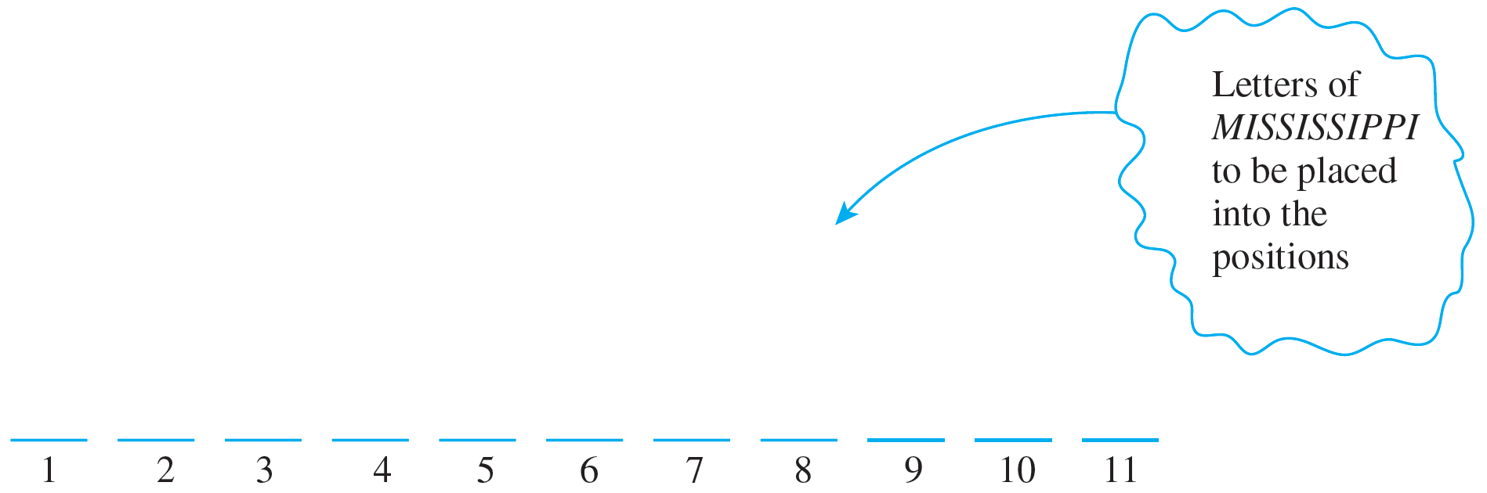
Example 9.5.11 – Solution
This example generalizes Example 9.5.10. Imagine placing the 11 letters of MISSISSIPPI one after another into 11 positions.
Because copies of the same letter cannot be distinguished from one another, once the positions for a certain letter are known, then all copies of the letter can go into the positions in any order.

Slide 34

Example 9.5.11 – Solution
continued
It follows that constructing an ordering for the letters can be thought of as a four-step process:
Step 1: Choose a subset of four positions for the S’s.
Step 2: Choose a subset of four positions for the I’s.
Step 3: Choose a subset of two positions for the P’s.
Step 4: Choose a subset of one position for the M.
Since there are 11 positions in all, there are
subsets of four positions for the S’s.

Slide 35



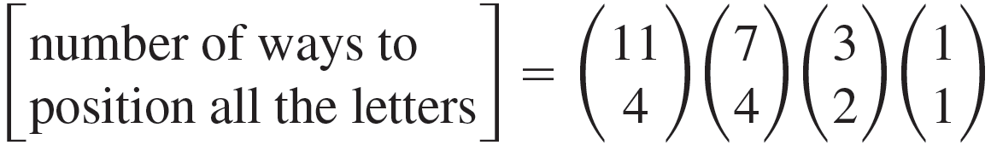
Example 9.5.11 – Solution
continued
Once the four S’s are in place, there are seven positions that remain empty, so there are
subsets of four positions for the I’s. After the I’s are in place, there are three positions
left empty, so there are
subsets of two positions for the
P’s. That leaves just one position for the M. But
Hence by the multiplication rule,

Slide 36
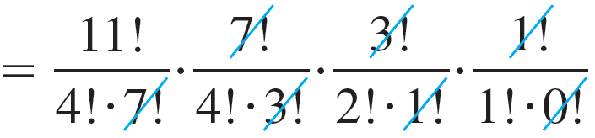
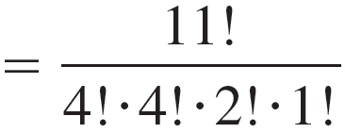

Example 9.5.11 – Solution
continued

Slide 37
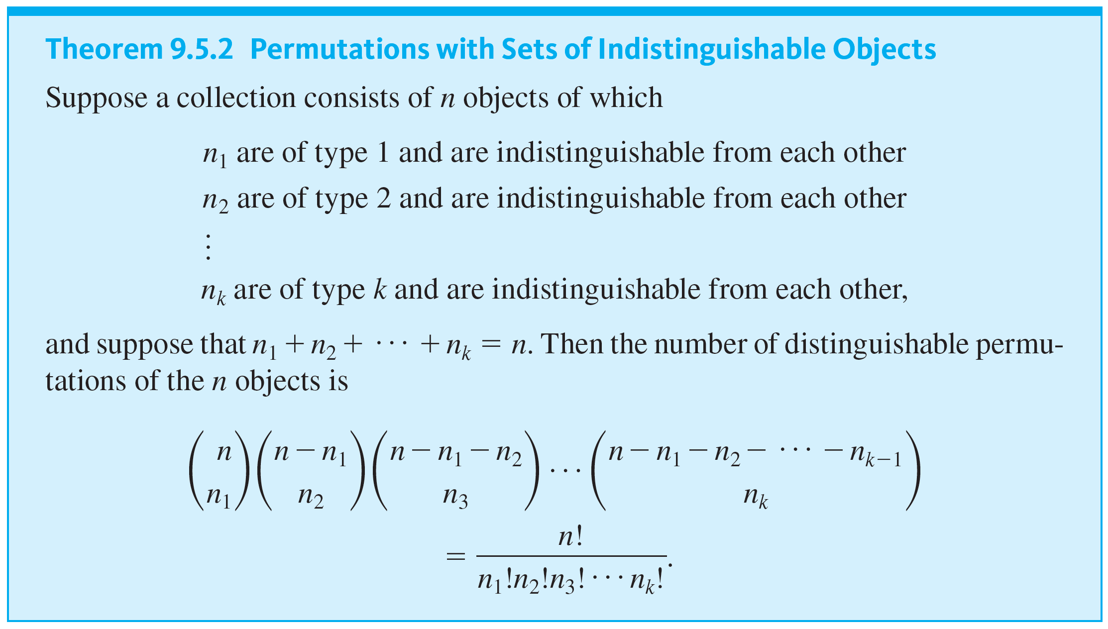
Counting Subsets of a Set: Combinations

Slide 38
Some Advice about Counting

Slide 39

Example 9.5.12 – Double Counting
A group consists of five men and seven women. How many teams of five contain at least one man?
Incorrect Solution
Imagine constructing the team as a two-step process:
Step 1: Choose a subset of one man from the five men.
Step 2: Choose a subset of four others from the remaining eleven people.
Hence, by the multiplication rule, there are
five-person teams that contain at least one man.

Slide 40
Example 9.5.12 – Double Counting
continued
Analysis of the Incorrect Solution The problem with the solution above is that some teams are counted more than once. Suppose the men are Anwar, Ben, Carlos, Dwayne, and Ed and the women are Fumiko, Gail, Hui-Fan, Inez, Jill, Kim, and Laura.
According to the method described previously, one possible outcome of the two-step process is as follows:
Outcome of step 1: Anwar
Outcome of step 2: Ben, Gail, Inez, and Jill.

Slide 41
Example 9.5.12 – Double Counting
continued
In this case the team would be {Anwar, Ben, Gail, Inez, Jill}. But another possible outcome is
Outcome of step 1: Ben
Outcome of step 2: Anwar, Gail, Inez, and Jill,
which also gives the team {Anwar, Ben, Gail, Inez, Jill}. Thus this one team is given by two different branches of the possibility tree, and so it is counted twice.

